Slide 1

CIS 543: FINAL PROJECT
COVID & MENTAL HEALTH
COVID & MENTAL HEALTH
Arianna, Enzo, Raul
December 8th, 2020

Slide 2



How does COVID-19 impact Mental Health?
Frontline and Emergency Workers
People that Tested Positive or Have COVID
Vaccine Expectations

Slide 3
Project objective:
Understand the Sentiment and Feelings of Twitter Users around different categories of COVID-19
#COVID #VACCINE #MENTALHEALTH

Slide 4
Motivation
Solidarity
Awareness
Expectations
Let’s be more understanding and find out the emotions and issues that frontline and emergency workers go through.
#Heroes
COVID IS REAL, no matter who or what you believe in. We will all be affected by it. Let’s see what it feels like to have COVID.
#WeWillGetThrough
We all want the pandemic to be OVER, but how will that happen? Will people get the vaccine? Do they feel confident about it?
#VaccinesWork

Slide 5
How Covid-19 impacted the people who were infected and/or tested positive for the disease?
Covid-19 has been trending topic in all information and social platforms for the past year.
“I have Covid-19”, “I got symptoms.” “I tested positive.” these words have become more and more common since the pandemic began.
The objective is to identify users that have informed in Twitter that they had Covid-19 symptoms or had a positive diagnosis.

Slide 6
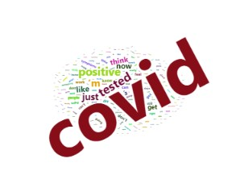
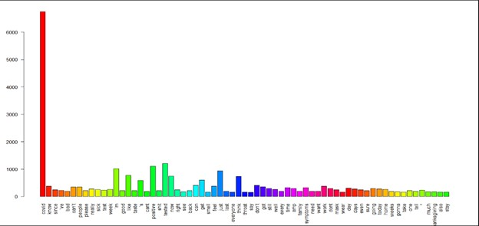
Sentiment Analysis
Exploring some principal phrases like “I have Covid-19.” “I got symptoms.” “I test positive”
We found that the phrases where mentioned with the wide range of instances like 5,429 for “I have Covid”, 1,067 for “I test Positive” and just 316 for “I got Symptoms”.
We made a histogram for the most common word uses and covid is mentioned in the tweets text 6,495 times for 6,443 tweets downloaded

Slide 7
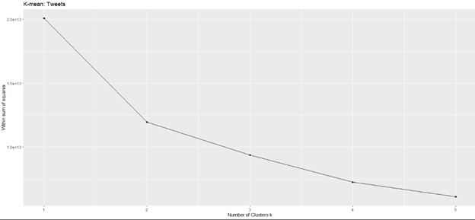
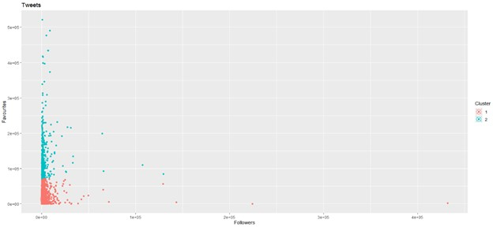
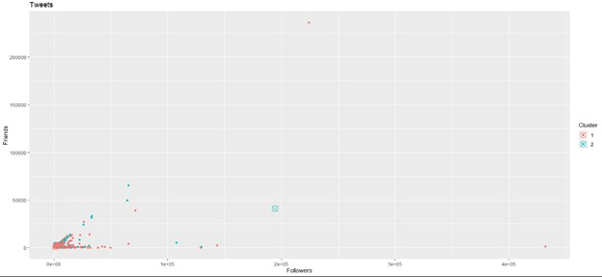
Cluster Analysis
We selected the variables that work for the model.
The Elbow method is to define clusters and the cluster inside variation.
The following K-mean cluster indicate that two cluster is the distribution for this data for “followers” and “favorites”.
The second cluster analysis data show that the within cluster sum of sum squares is 53.2%.
Notes:
Not enough with the tweets I decide to build a cluster test word for the text tweets and the result was that the ‘covid ‘ as a principal selection it’s connect with two other “positive , test” and “mask and wear”. We can appreciate this in the Hierarchical word/tweeter clustering using dendrogram.

Slide 8
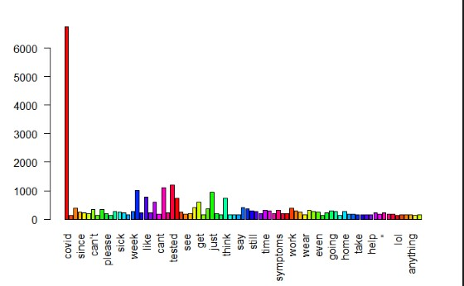
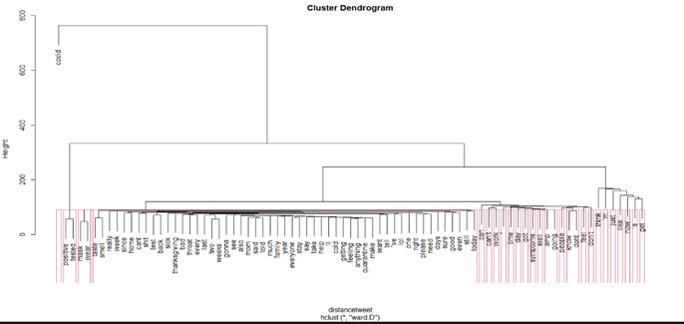
Cluster of Test/ Tweet
We decided to build a cluster test word for the text tweets and the result was that the ‘covid ‘ as a principal selection it’s connect with two other “positive , test” and “mask and wear”.
We can appreciate this in the Hierarchical word/tweeter clustering using dendrogram.
Notes:
Not enough with the tweets I decide to build a cluster test word for the text tweets and the result was that the ‘covid ‘ as a principal selection it’s connect with two other “positive , test” and “mask and wear”. We can appreciate this in the Hierarchical word/tweeter clustering using dendrogram.

Slide 9
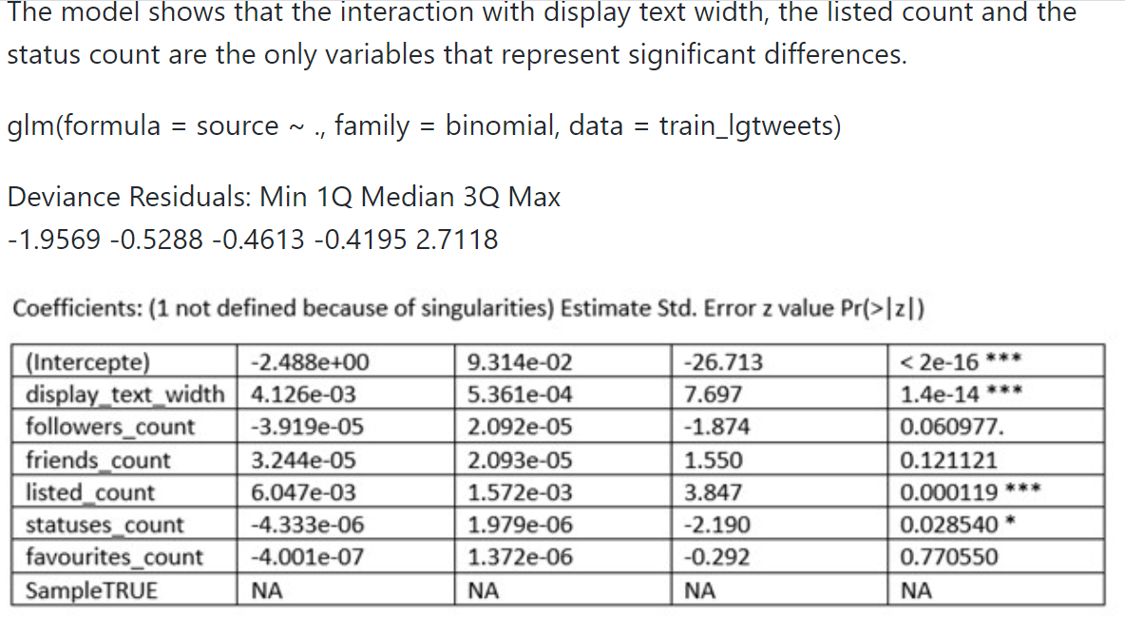
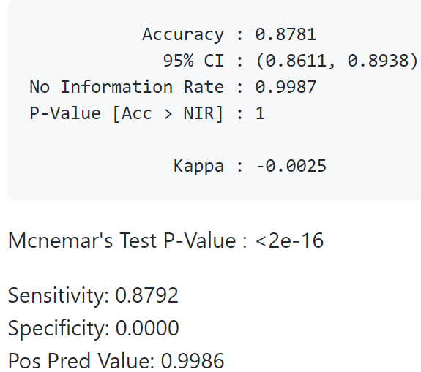
Logistic Model
The model shows that the interaction with display text width, the listed count and the status count are the only variables that represent significant differences.
Notes:
Not enough with the tweets I decide to build a cluster test word for the text tweets and the result was that the ‘covid ‘ as a principal selection it’s connect with two other “positive , test” and “mask and wear”. We can appreciate this in the Hierarchical word/tweeter clustering using dendrogram.

Slide 10
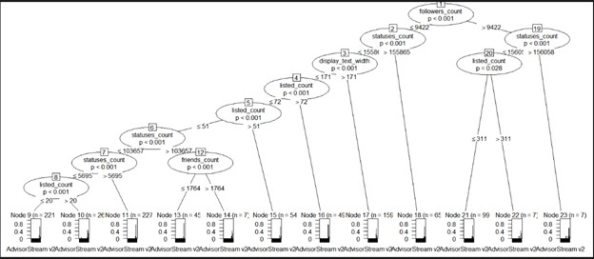
Decision Tree
The accuracy of the model is 67.41%
Notes:
Not enough with the tweets I decide to build a cluster test word for the text tweets and the result was that the ‘covid ‘ as a principal selection it’s connect with two other “positive , test” and “mask and wear”. We can appreciate this in the Hierarchical word/tweeter clustering using dendrogram.

Slide 11
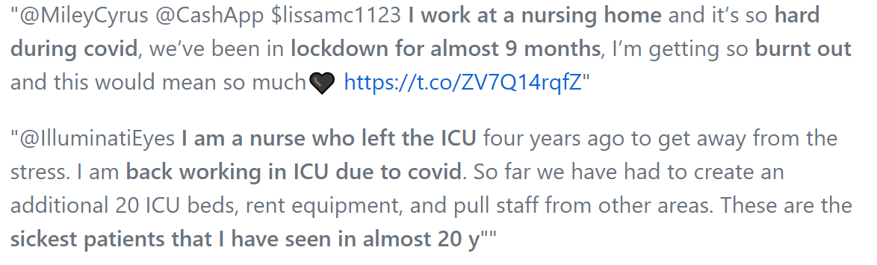
How Covid-19 impacted front line and emergency workers
Our Team collected a sample of 993 tweets in the month of October of 2020
The objective of the search queries was to find the Twitter users that are front line workers.
We extracted the timelines of those users up to 400 tweets back in time

Slide 12
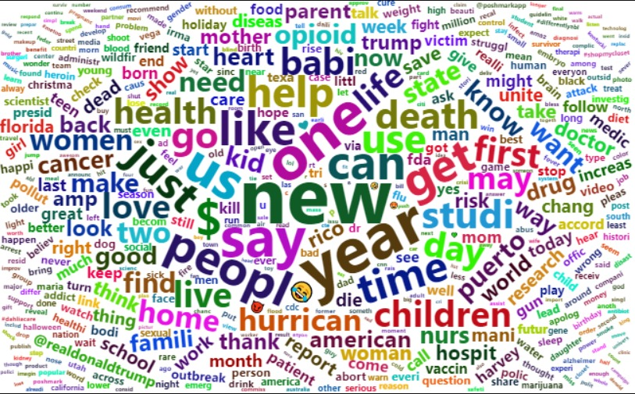
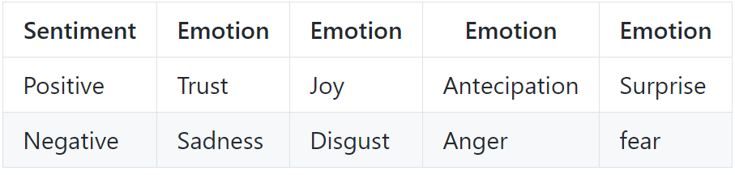
Sentiment Analysis
Our team utilized the NRC Word-Emotion Association Lexicon from the package syuzhet
The package utilizes a crowdsource dictionary were people assigned several thousands of words to different feelings and emotions
500 More Frequent Words Frontline Workers Before 2020

Slide 13
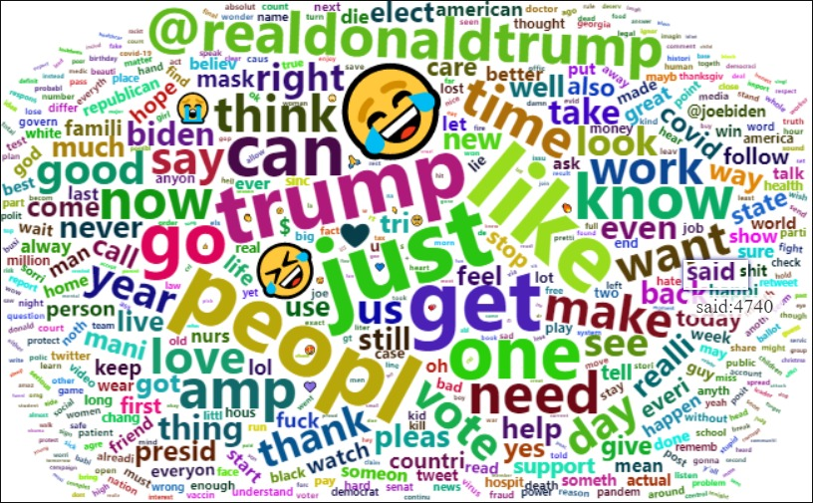
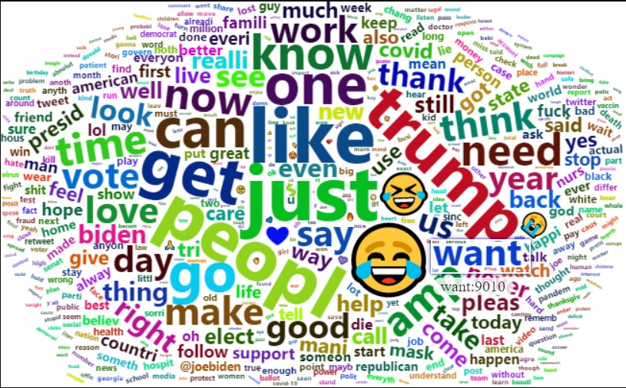
Front Line workers Tweets During the First Half vs Second Half of 2020

Slide 14
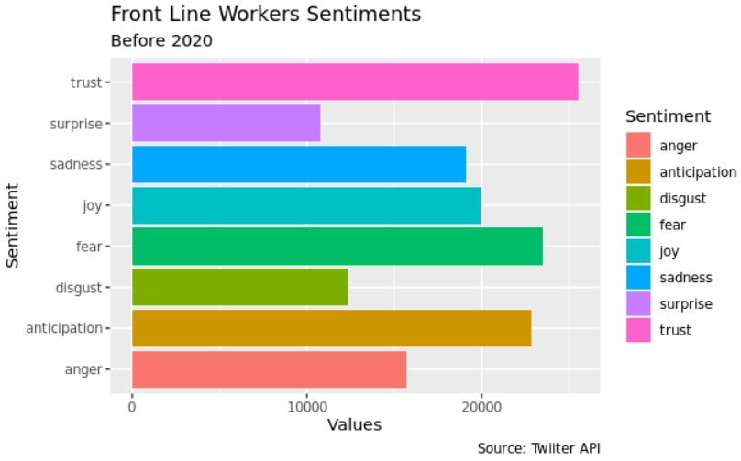
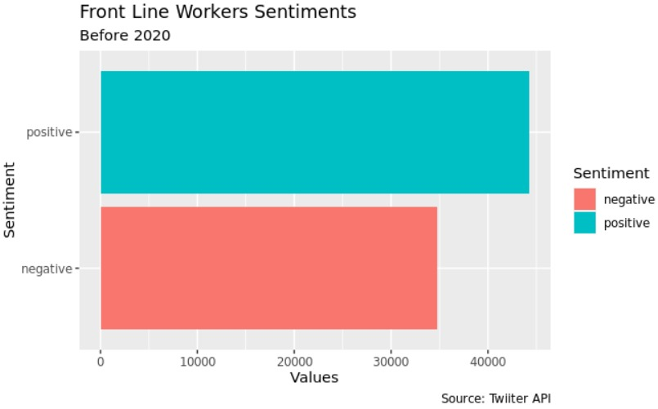
FRONTLINE WORKERS BEFORE 2020

Slide 15
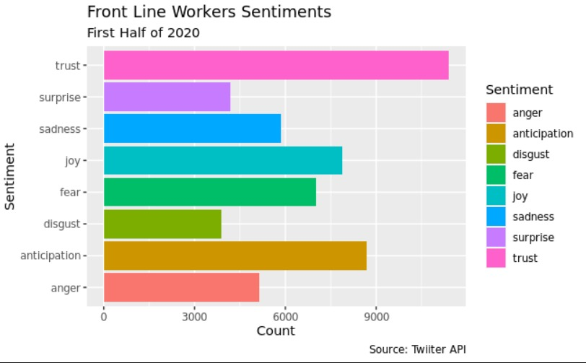
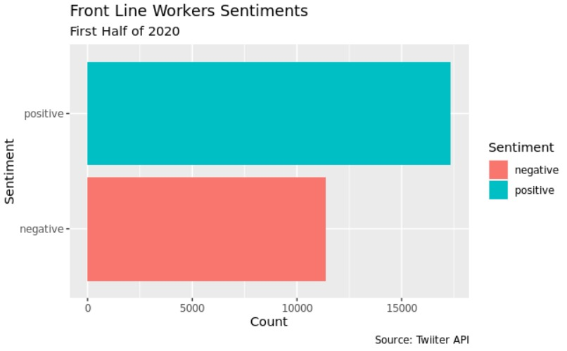
FRONTLINE WORKERS
FIRST HALF 2020

Slide 16
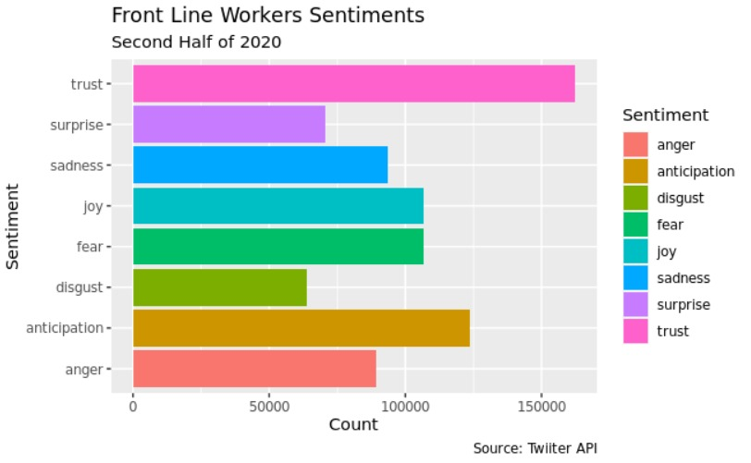
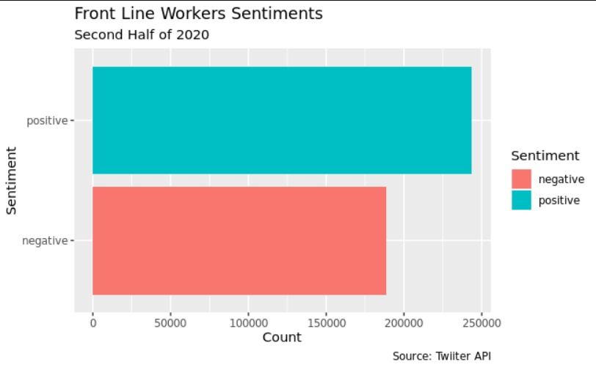
FRONTLINE WORKERS
SECOND HALF 2020

Slide 17
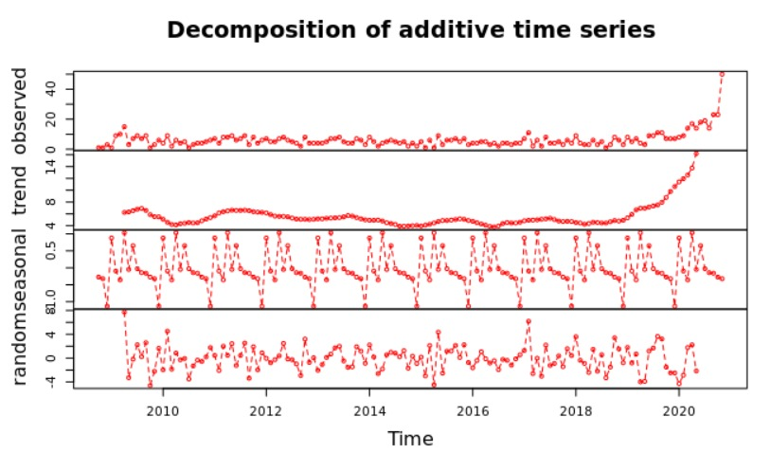
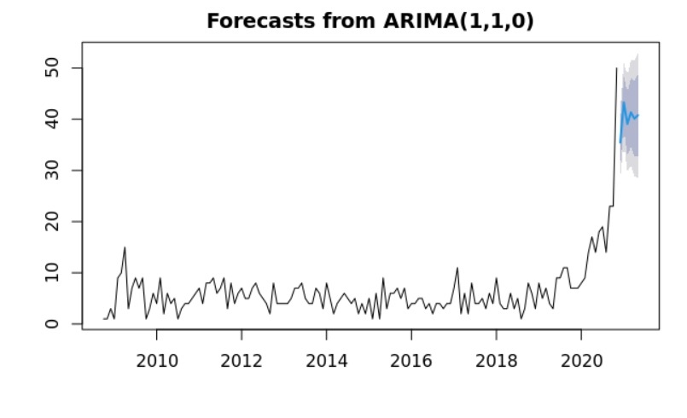
TIME SERIES ANALYSIS I
This time series takes into account the number of accounts created over time.
Followed by a forecast of the next 6 months.
As we can observe in the year of 2020 there was a boom of accounts created among the frontline workers.

Slide 18
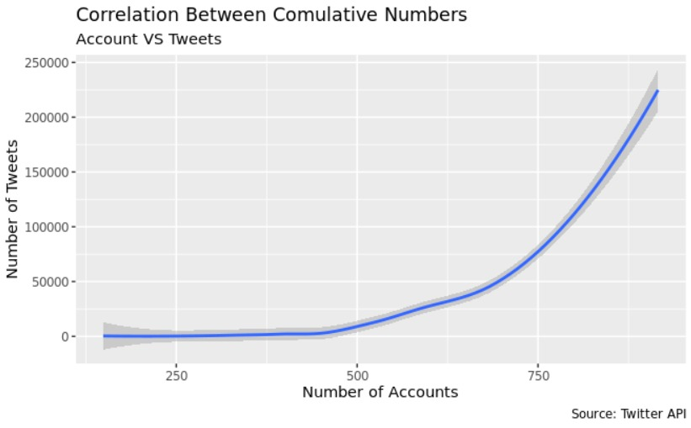
NON LINEAR REGRESSION
Our team performed a non linear regression to predict the cumulative number of tweets given the cumulative number of accounts.
The graph demonstrates the exponential relationship between the cumulative number of accounts created and the cumulative number of tweets.

Slide 19
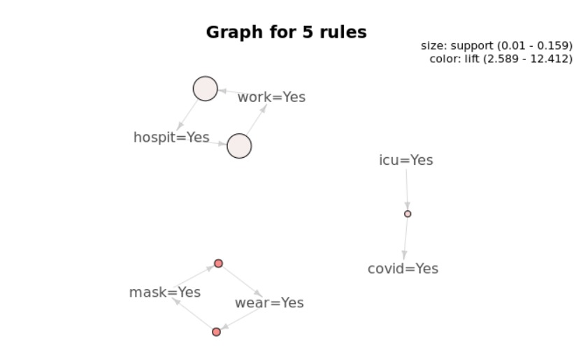
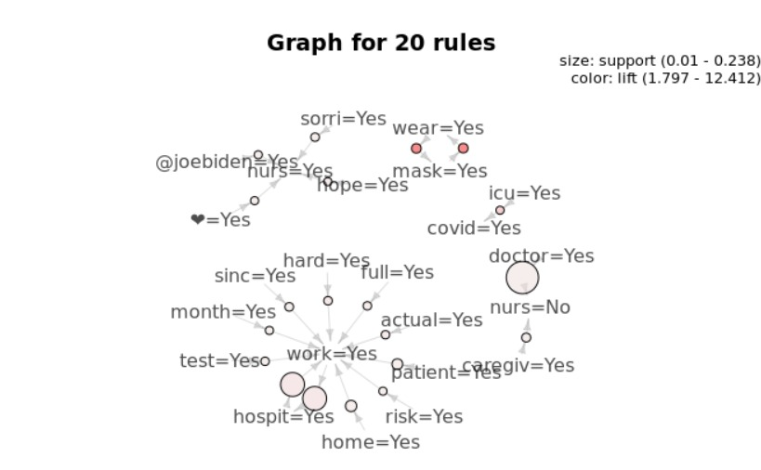
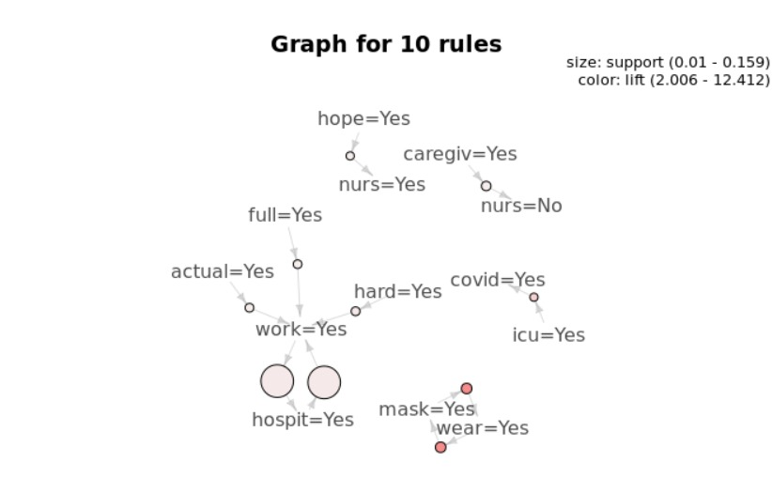
Association Rules
The following graphs are ordered respectively by the 5, 10 and 20 words with the most expressive lifts. Our team utilized as threshold 0.01 of support and 0.5 of confidence that resulted in more than 200000 association rules

Slide 20
What are the expectations around the COVID VACCINE?
We retrieved more than 18,000 tweets that included the word vaccine and #vaccine in the text.
The objective of the search queries was to find the Twitter emotions and adjectives that were tied together to the word “vaccine”

Slide 21
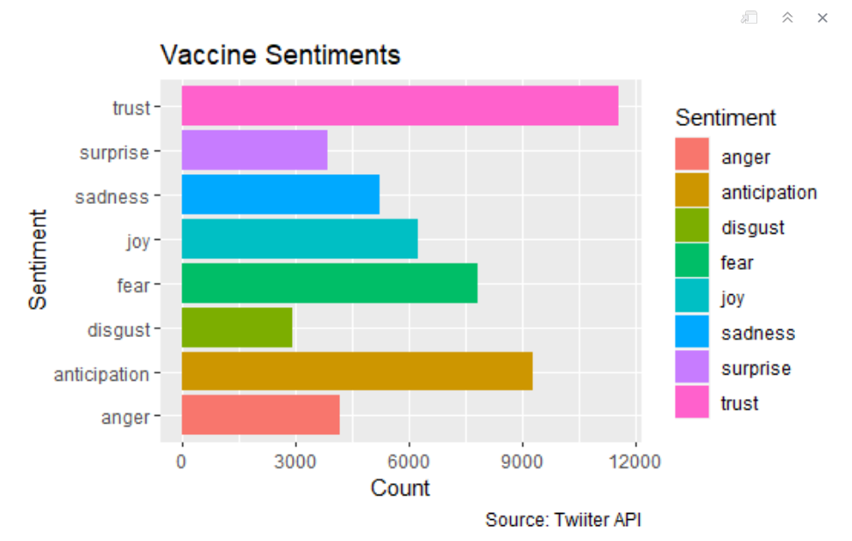
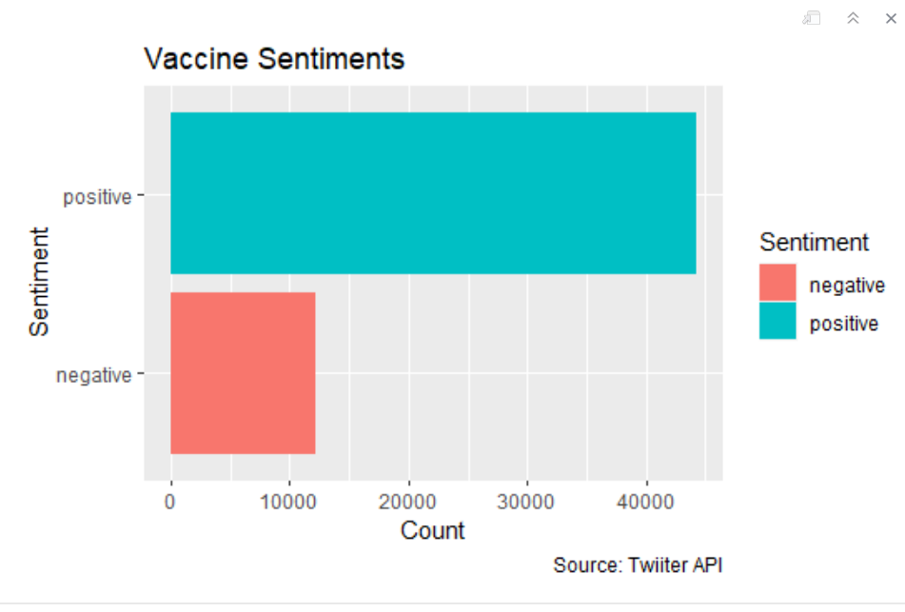
Vaccine Sentiments
We assigned a 1 to each time the tweet mentioned any of these words and at the end subtracted the negative words from the positive words.

Slide 22
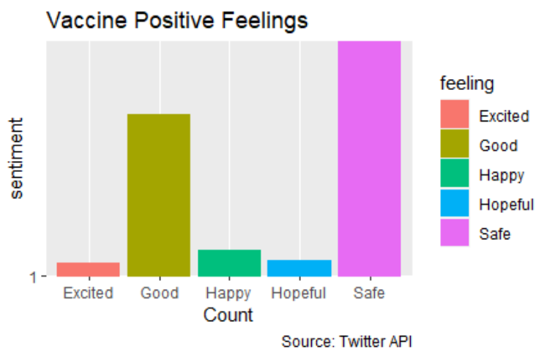
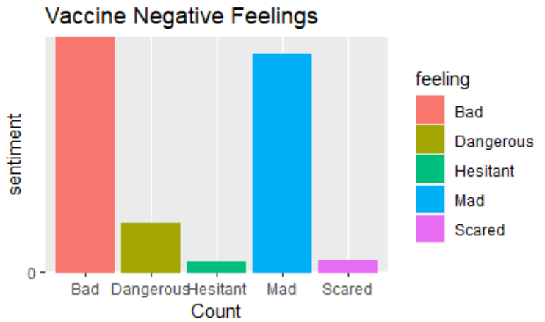
Vaccine Sentiments II
Also, we conducted a different type of analysis ("Vaccine Analysis 2") where we found the tweets that were Semantic Differential Adjectives (Opposites from each Other)

Slide 23
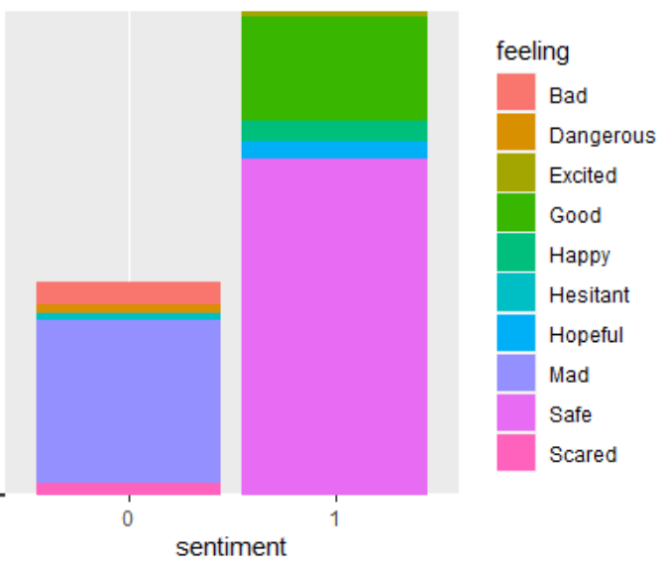
Are the Emotions around the Vaccine Positive or Negative?

Slide 24
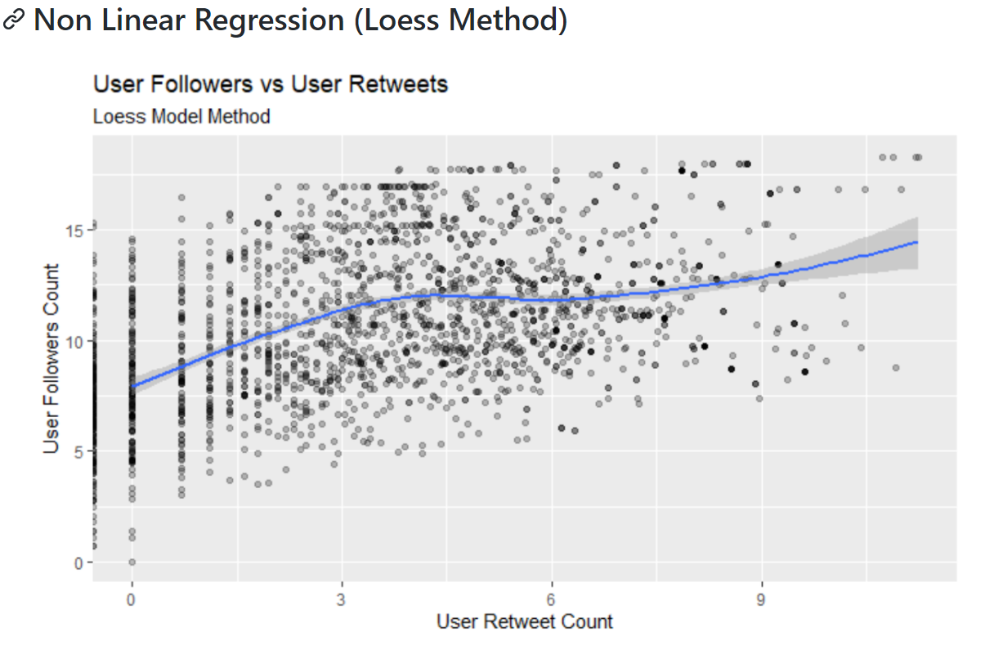
Loess Method
Is there a relationship between the follower count and the user retweets?

Slide 25
Conclusion
Frontline
Diagnosed
Vaccine
As we saw the front line workers, despite all challenges, remained with a positive attitude. Therefore, lets respect the front line workers resiliency and do one of the major requests in the their tweets "Wear -> Mask"
People that were diagnosed tweeted that home, showed us a big challenge they are facing: A complete social isolation for a period of 14 days
There are more positive feelings related to the vaccine, the predominant feeling is “safe” followed by “hopeful” and “happy”. The predominant negative feelings are “scared”, “mad”, “hesitant”

Slide 26
